Slide 1
OIL REFINERY
3D Presentation

Slide 2
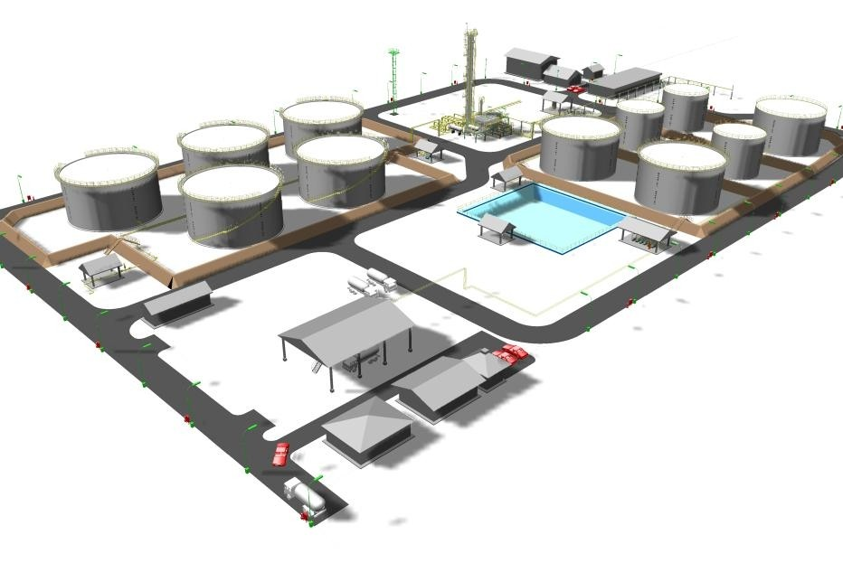
3D Presentation
Please, found attached a Sample 3D Presentation for a 150.000 Barrel per Day Refinery.
Such Presentation are part of any Planting NPP21wek and NIG are doing.

Slide 3
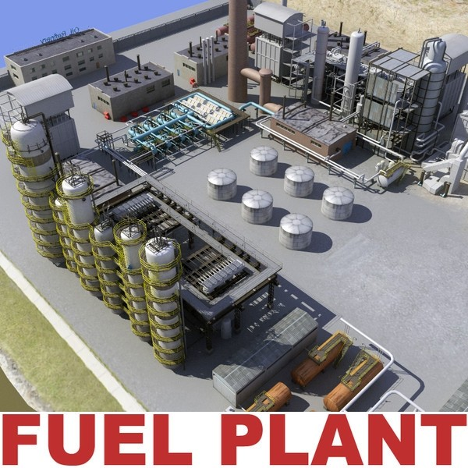
3D Presentation

Slide 4
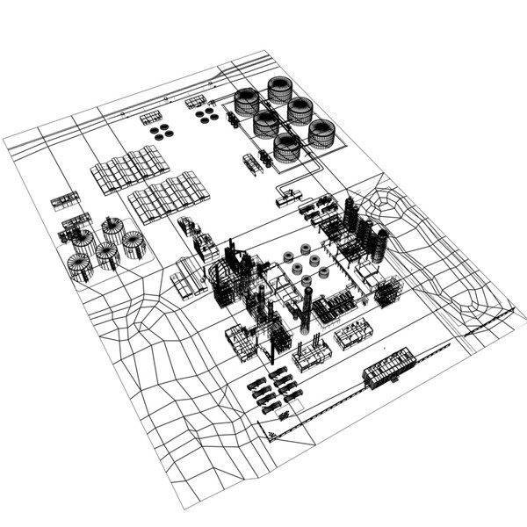
3D Presentation

Slide 5
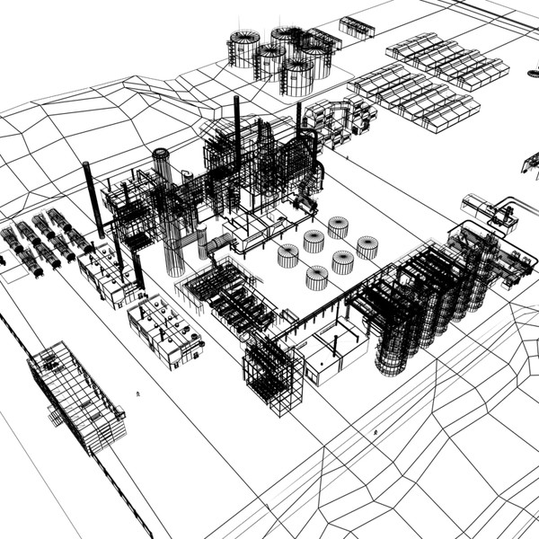
3D Presentation

Slide 6
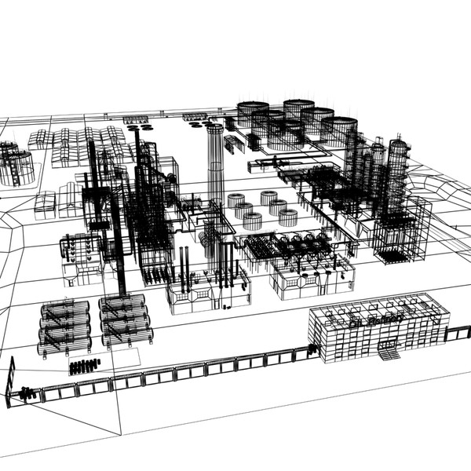
3D Presentation

Slide 7
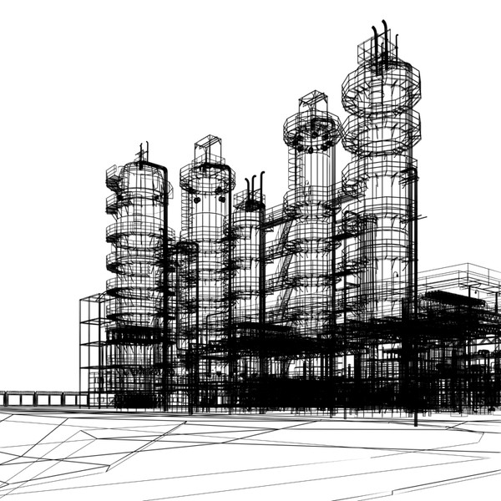
3D Presentation

Slide 8
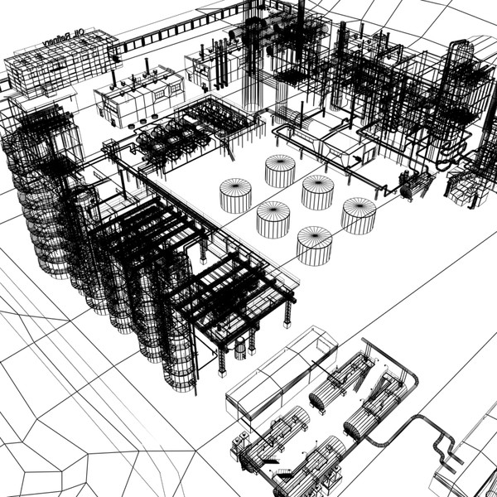
3D Presentation

Slide 9
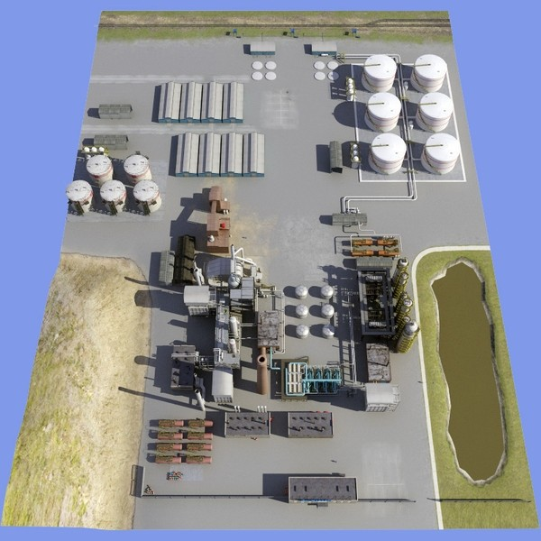
3D Presentation

Slide 10
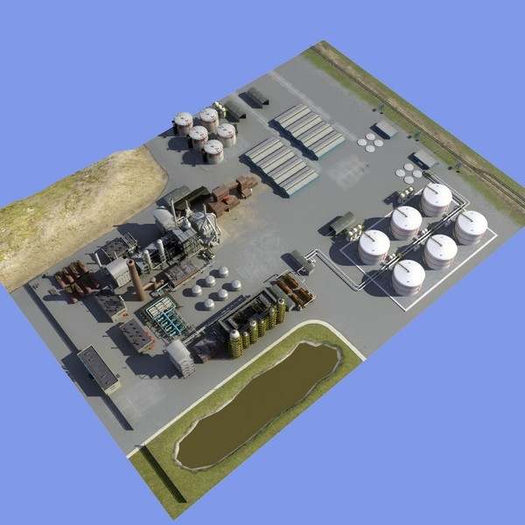
3D Presentation

Slide 11
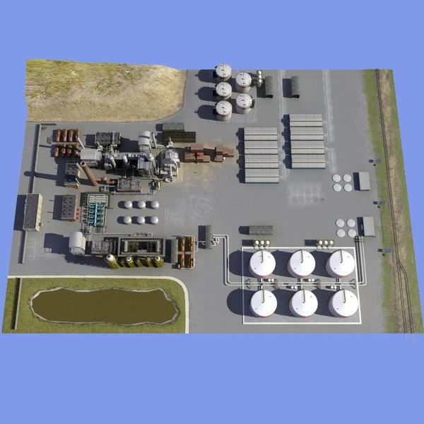
3D Presentation

Slide 12
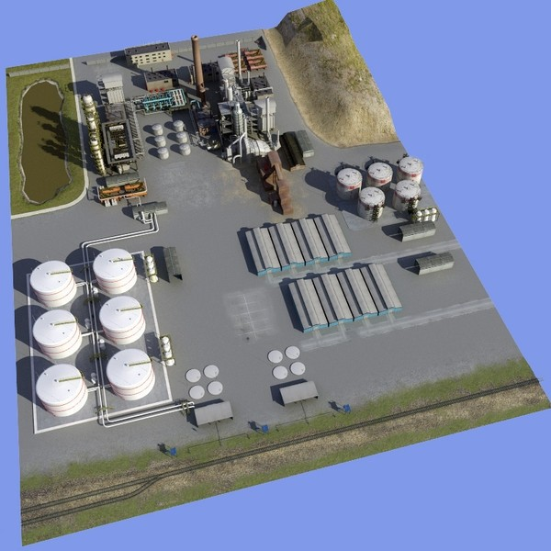
3D Presentation

Slide 13
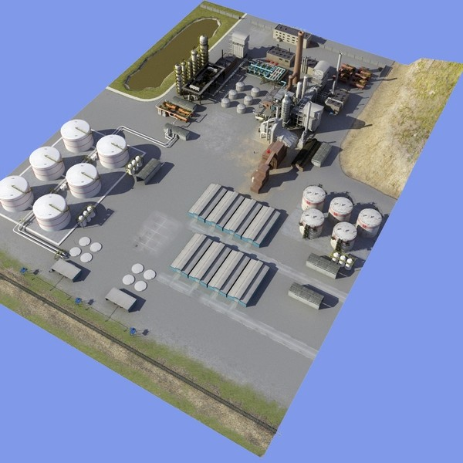
3D Presentation

Slide 14
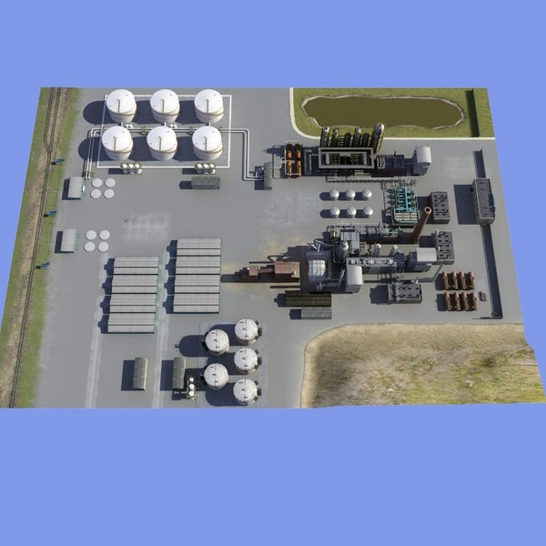
3D Presentation

Slide 15
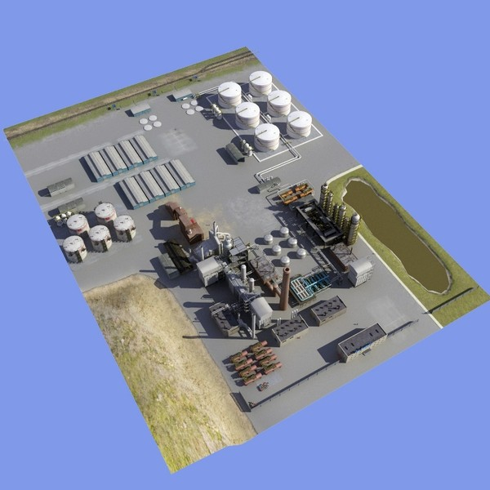
3D Presentation

Slide 16
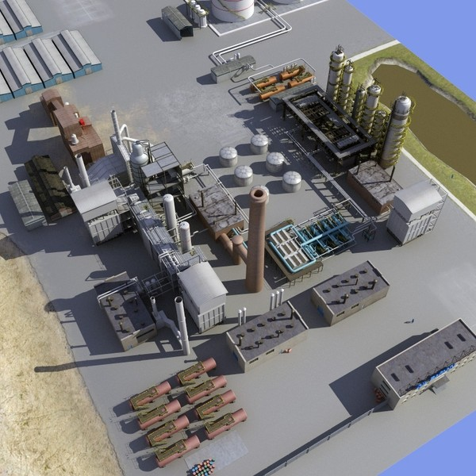
3D Presentation

Slide 17
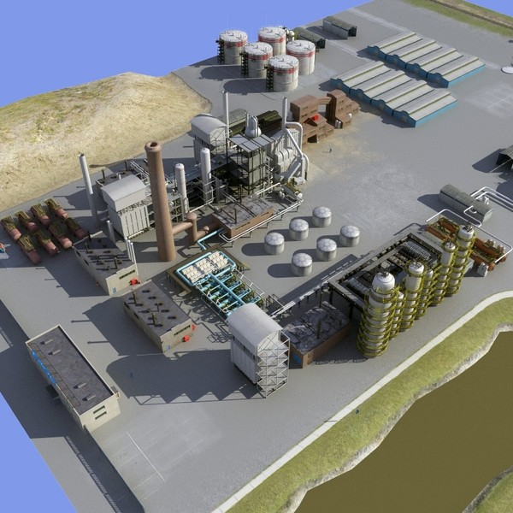
3D Presentation

Slide 18
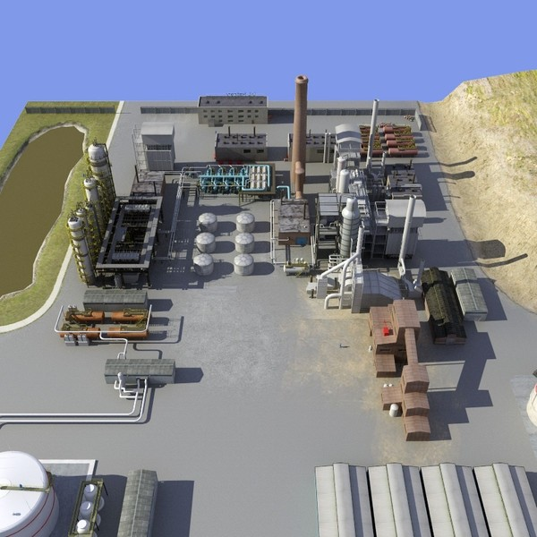
3D Presentation

Slide 19
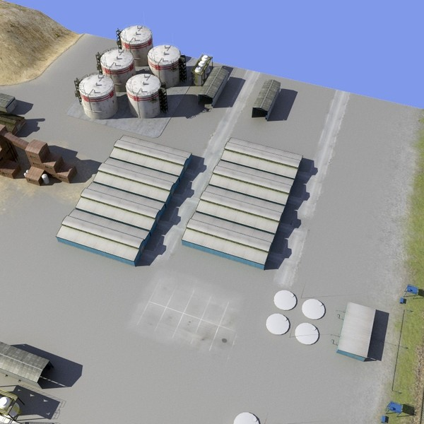
3D Presentation

Slide 20
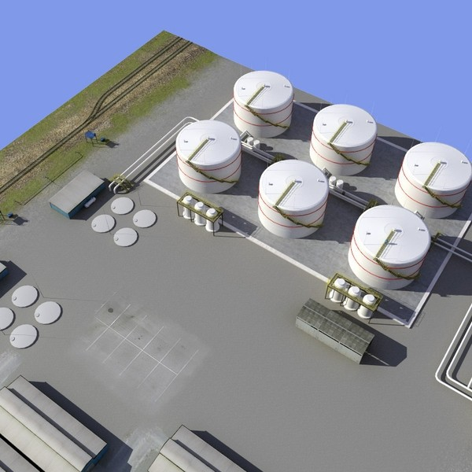
3D Presentation

Slide 21
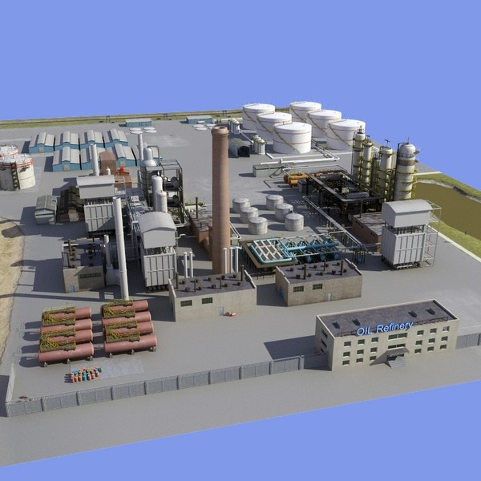
3D Presentation

Slide 22
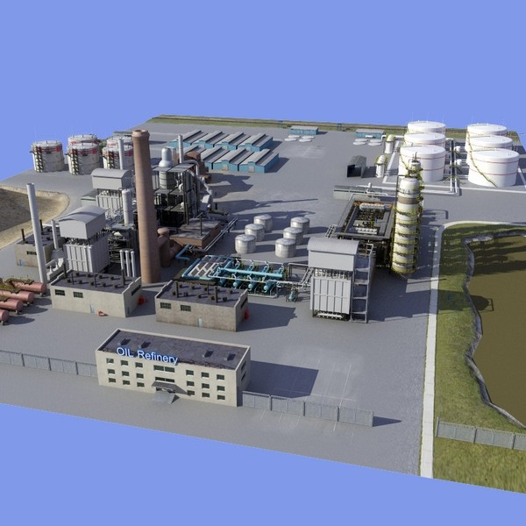
3D Presentation

Slide 23
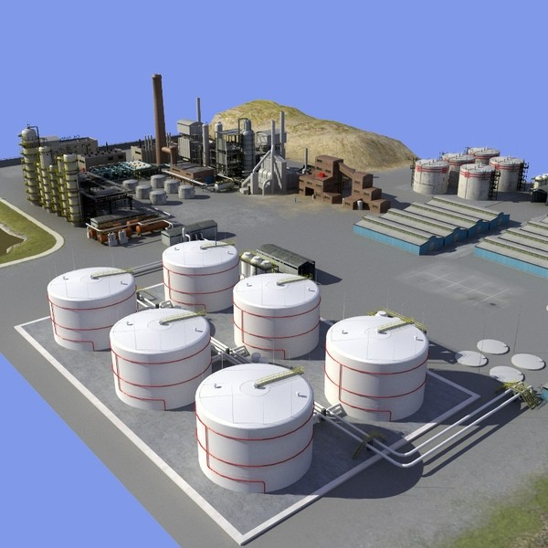
3D Presentation

Slide 24
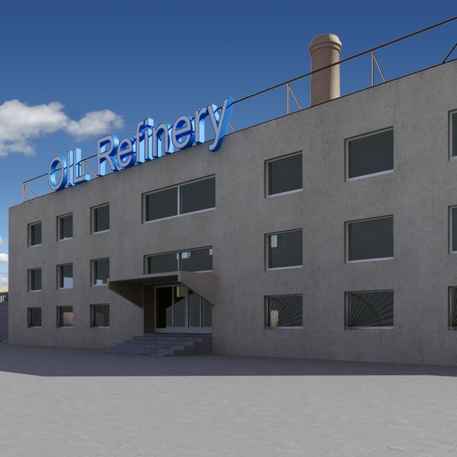
3D Presentation

Slide 25
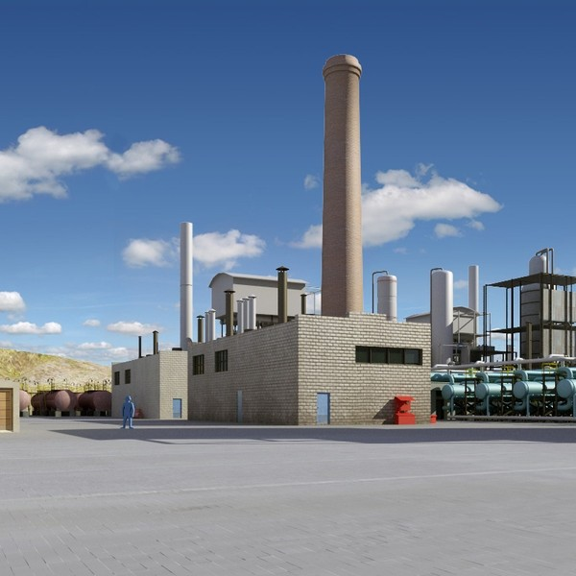
3D Presentation

Slide 26
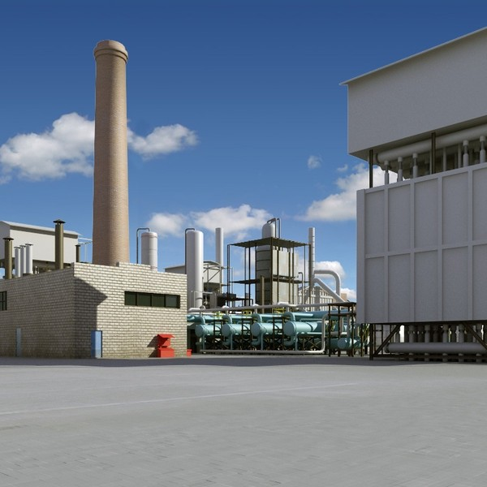
3D Presentation

Slide 27
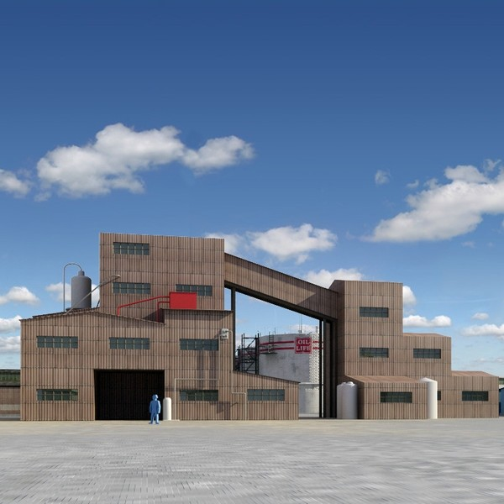
3D Presentation

Slide 28
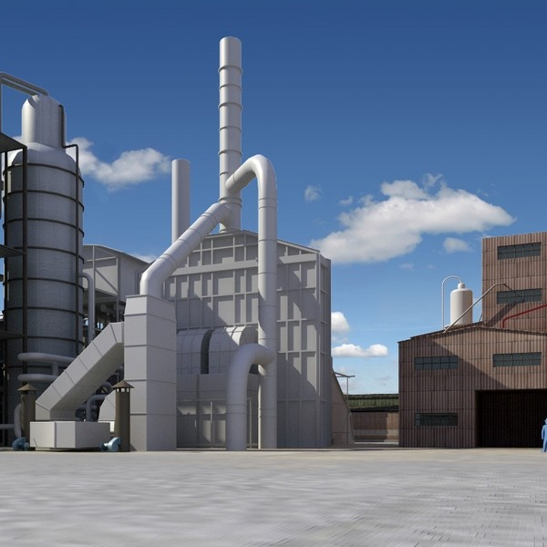
3D Presentation

Slide 29
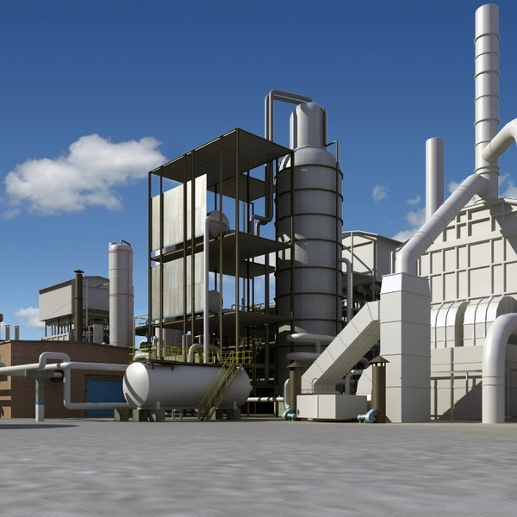
3D Presentation

Slide 30
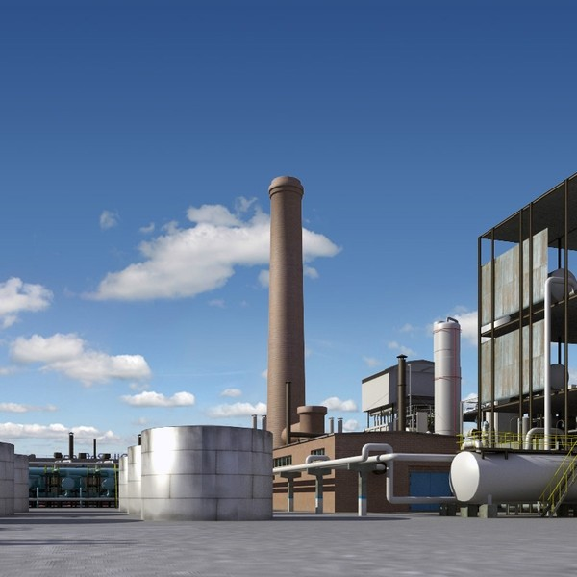
3D Presentation

Slide 31
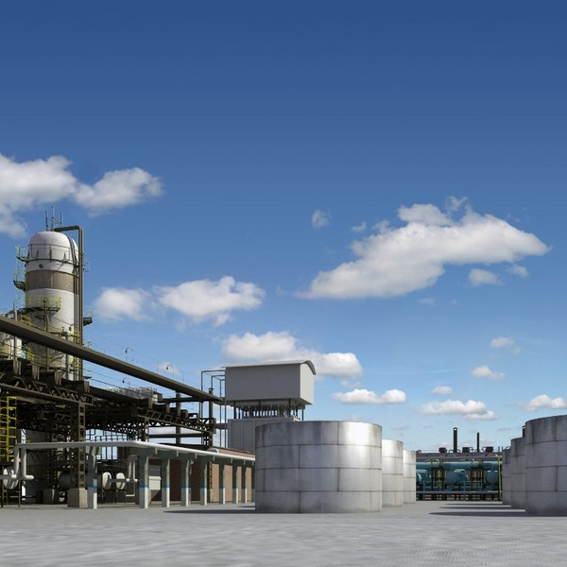
3D Presentation

Slide 32
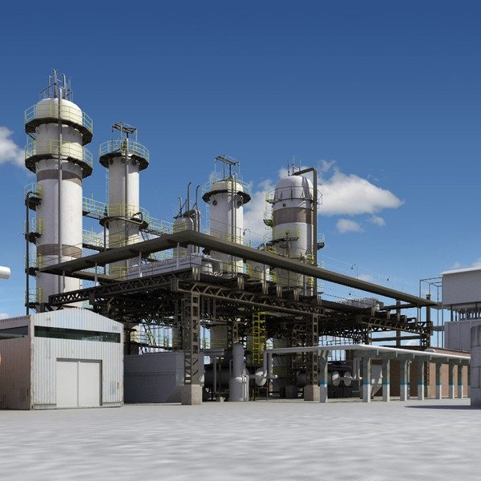
3D Presentation

Slide 33
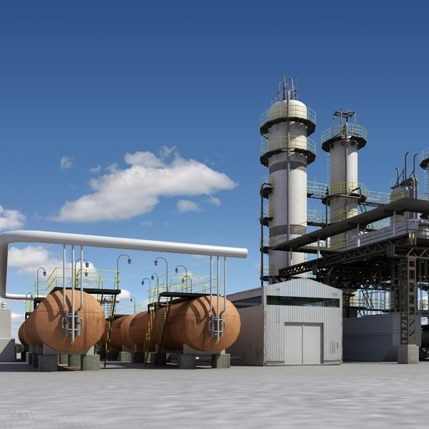
3D Presentation

Slide 34
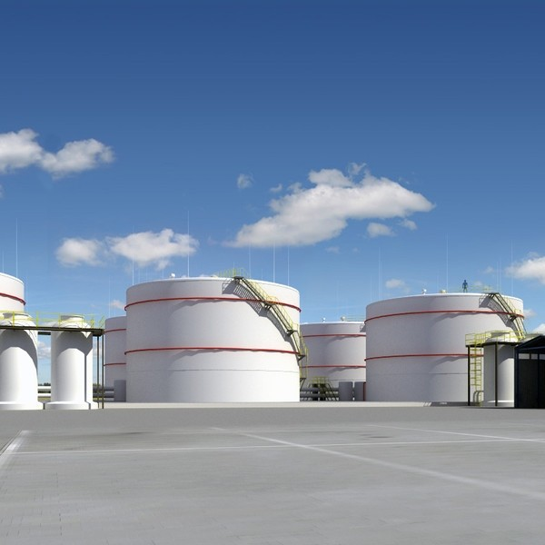
3D Presentation

Slide 35
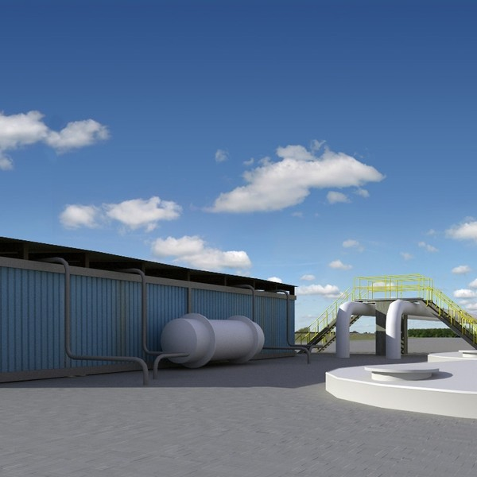
3D Presentation

Slide 36
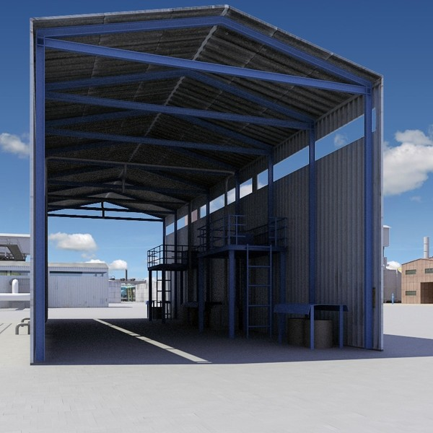
3D Presentation

Slide 37
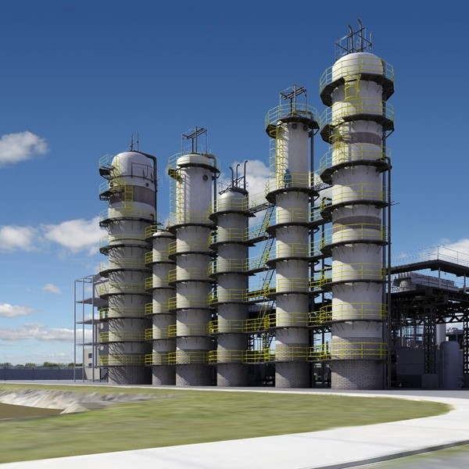
3D Presentation

Slide 38
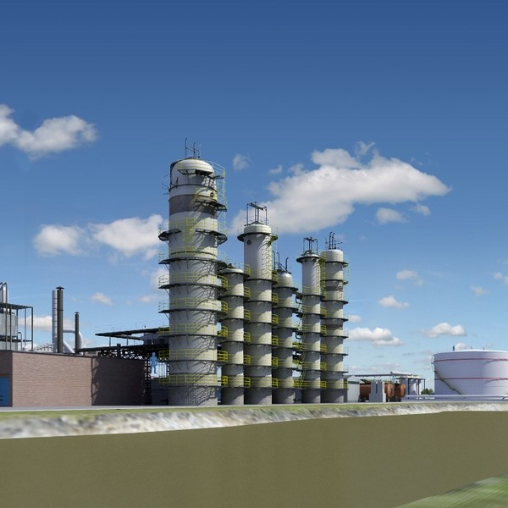
3D Presentation

Slide 39
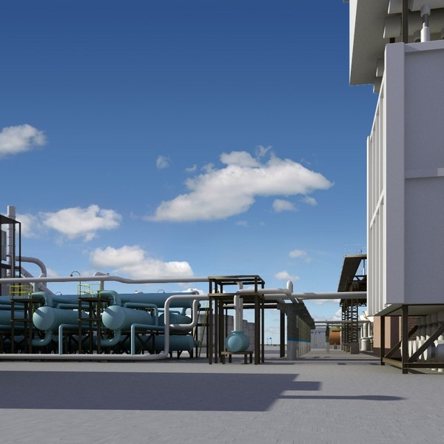
3D Presentation

Slide 40
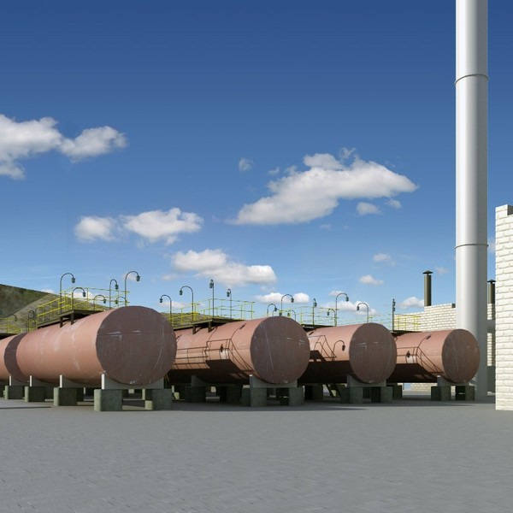
3D Presentation

Slide 41
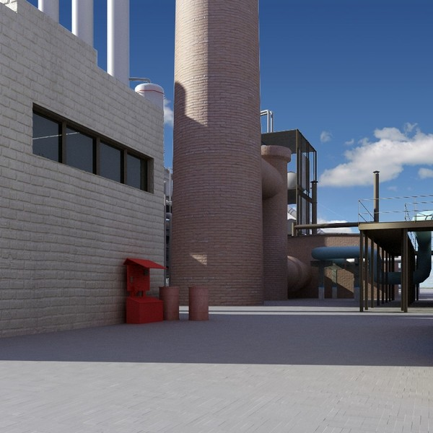
3D Presentation

Slide 42
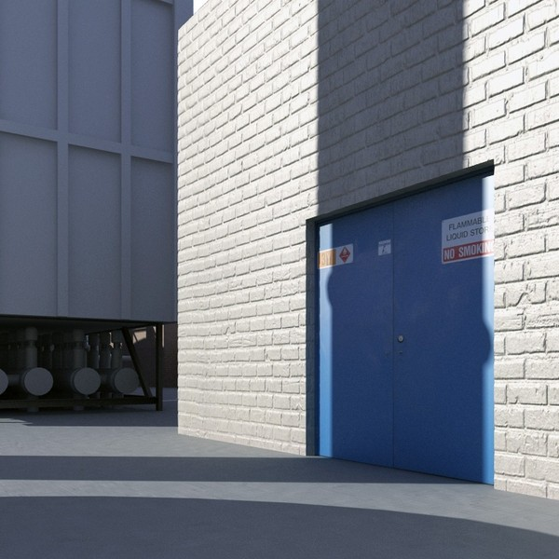
3D Presentation

Slide 43
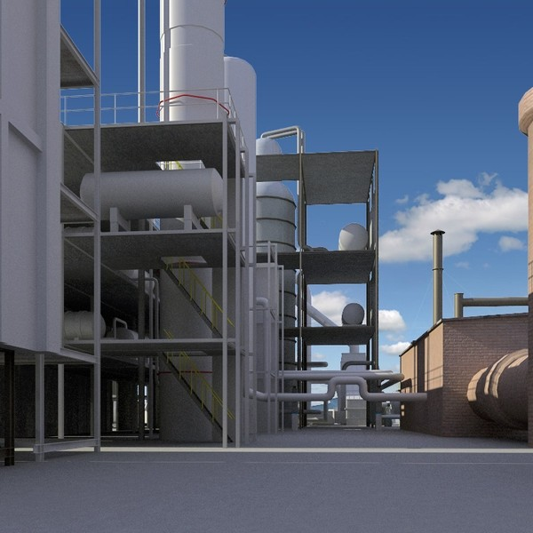
3D Presentation

Slide 44
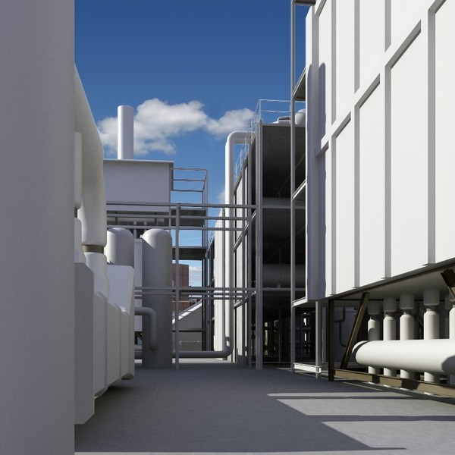
3D Presentation

Slide 45
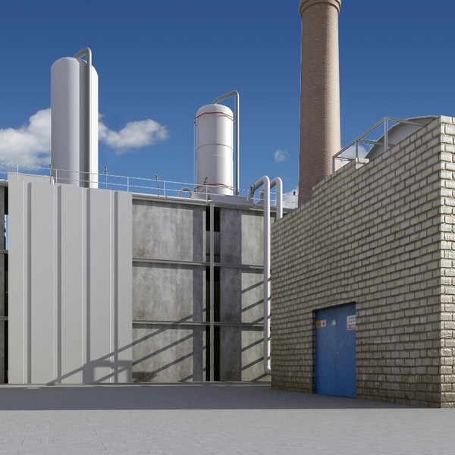
3D Presentation

Slide 46
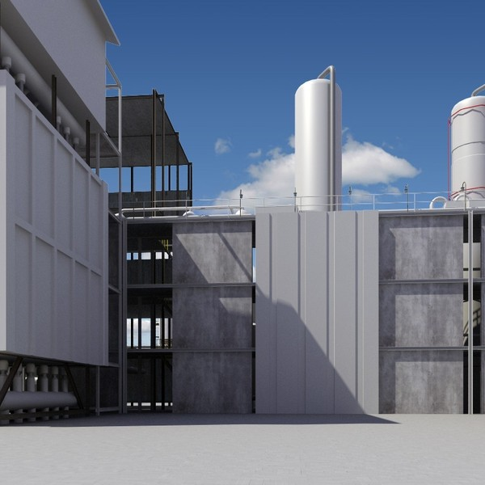
3D Presentation

Slide 47
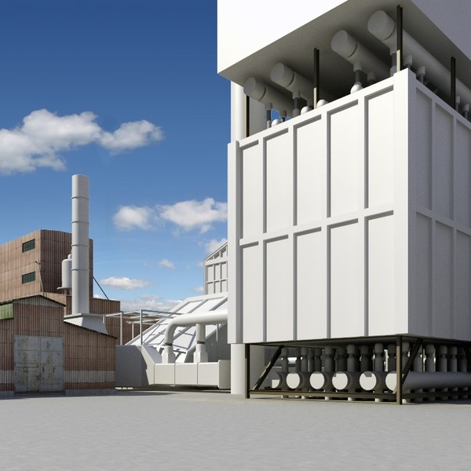
3D Presentation

Slide 48
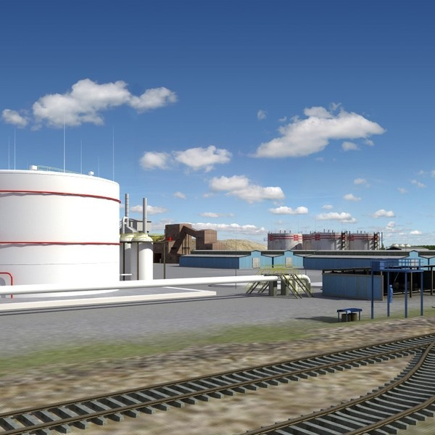
3D Presentation

Slide 49
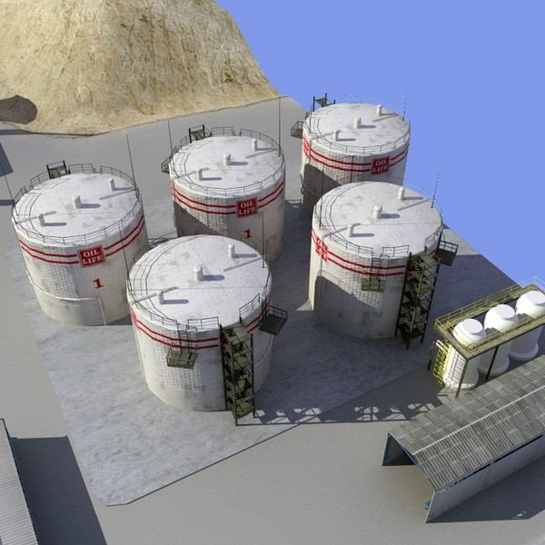
3D Presentation

Slide 50
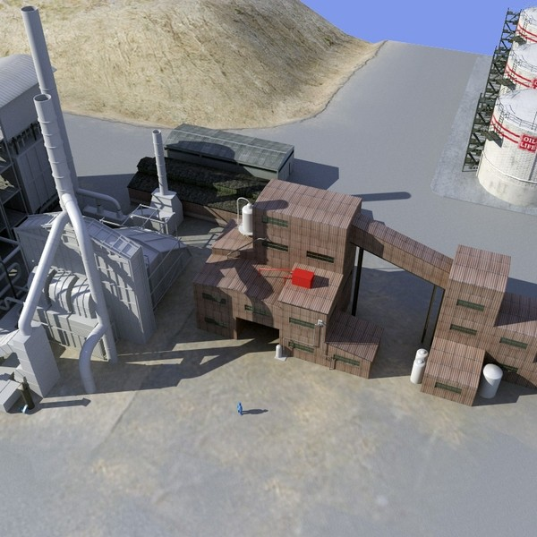
3D Presentation

Slide 51
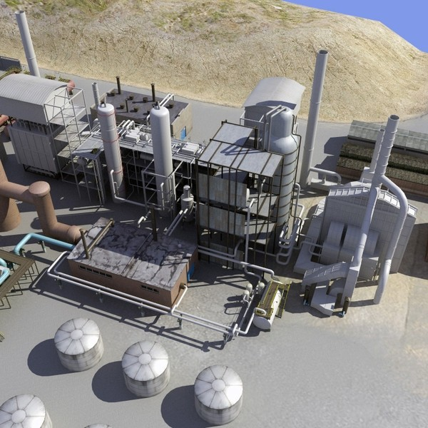
3D Presentation

Slide 52

3D Presentation

Slide 53

3D Presentation

Slide 54

3D Presentation

Slide 55

3D Presentation

Slide 56

3D Presentation

Slide 57

3D Presentation

Slide 58

3D Presentation

Slide 59

3D Presentation

Slide 60

3D Presentation

Slide 61

3D Presentation

Slide 62

3D Presentation

Slide 63

3D Presentation

Slide 64



3D Presentation

